Slide 1
Mining heritage and land use conflicts in the Swedish Arctic
Judit Malmgren
PhD Student
History
Notes:
1

Slide 2
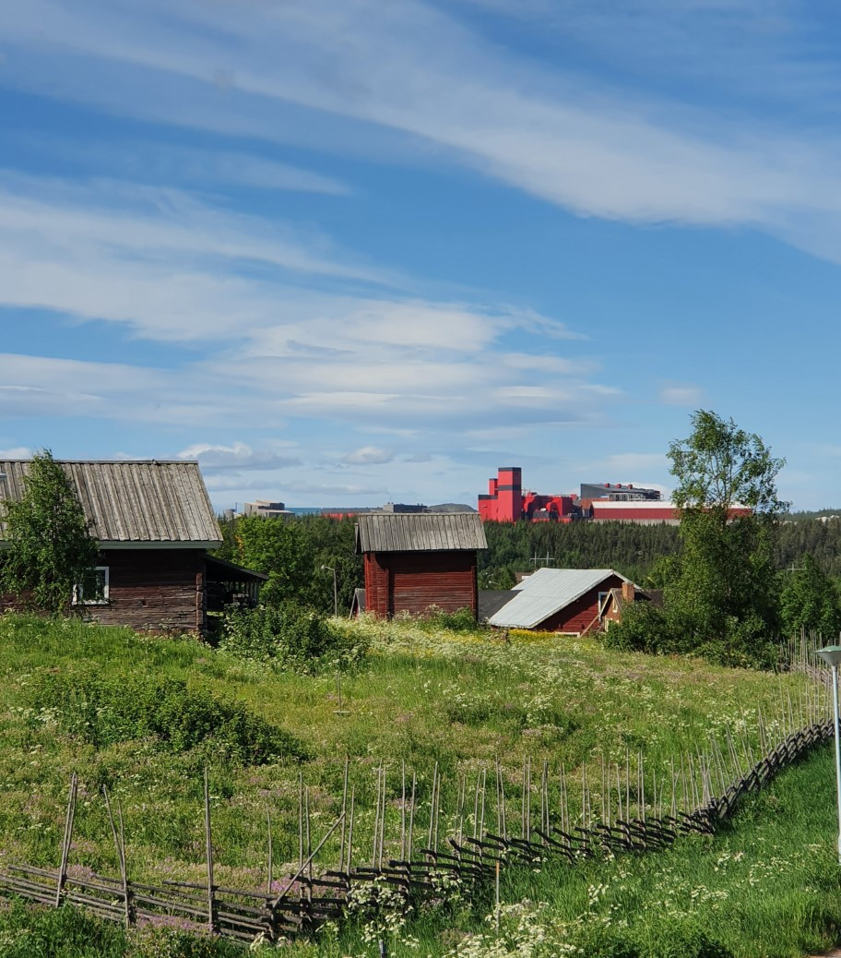
Mining
Requires large systems of infrastructure
Competing use of land
Competing perspectives
Demand for metals
Large mineral resources

Slide 3
Why a histoical perspective?
Conflicts emerge and change over time
Lack of in-depth studies, long perspectives and plurality
Lack of width, for example the impacts of the emerging socio-technical system and its many additional effects, both positive and negative

Slide 4
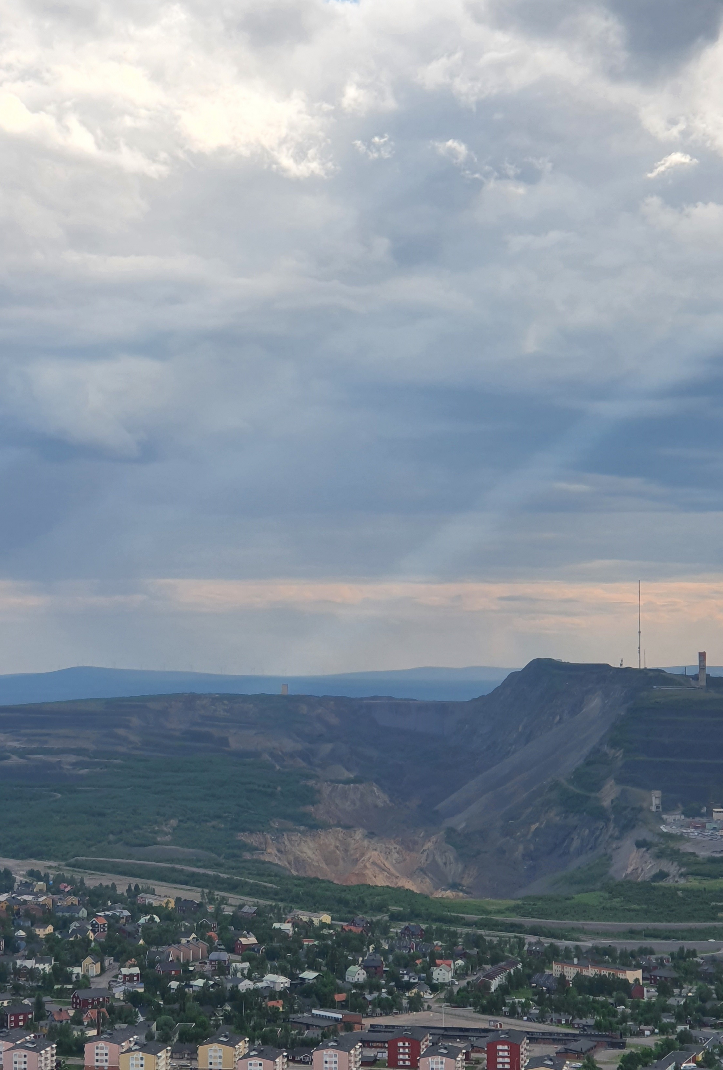
Social constructivism
Conflicts as competing systems of meaning
System theory
Case study method

Slide 5
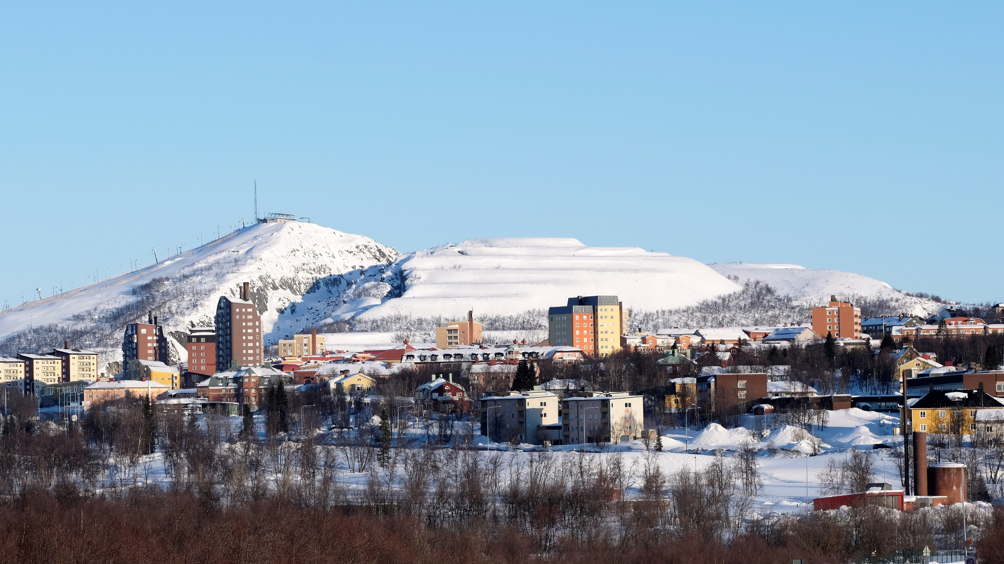
The Kiruna mine (LKAB)
Iron ore
Expansive phases: Establishment of the system, the post-war period and the mining boom

Slide 6
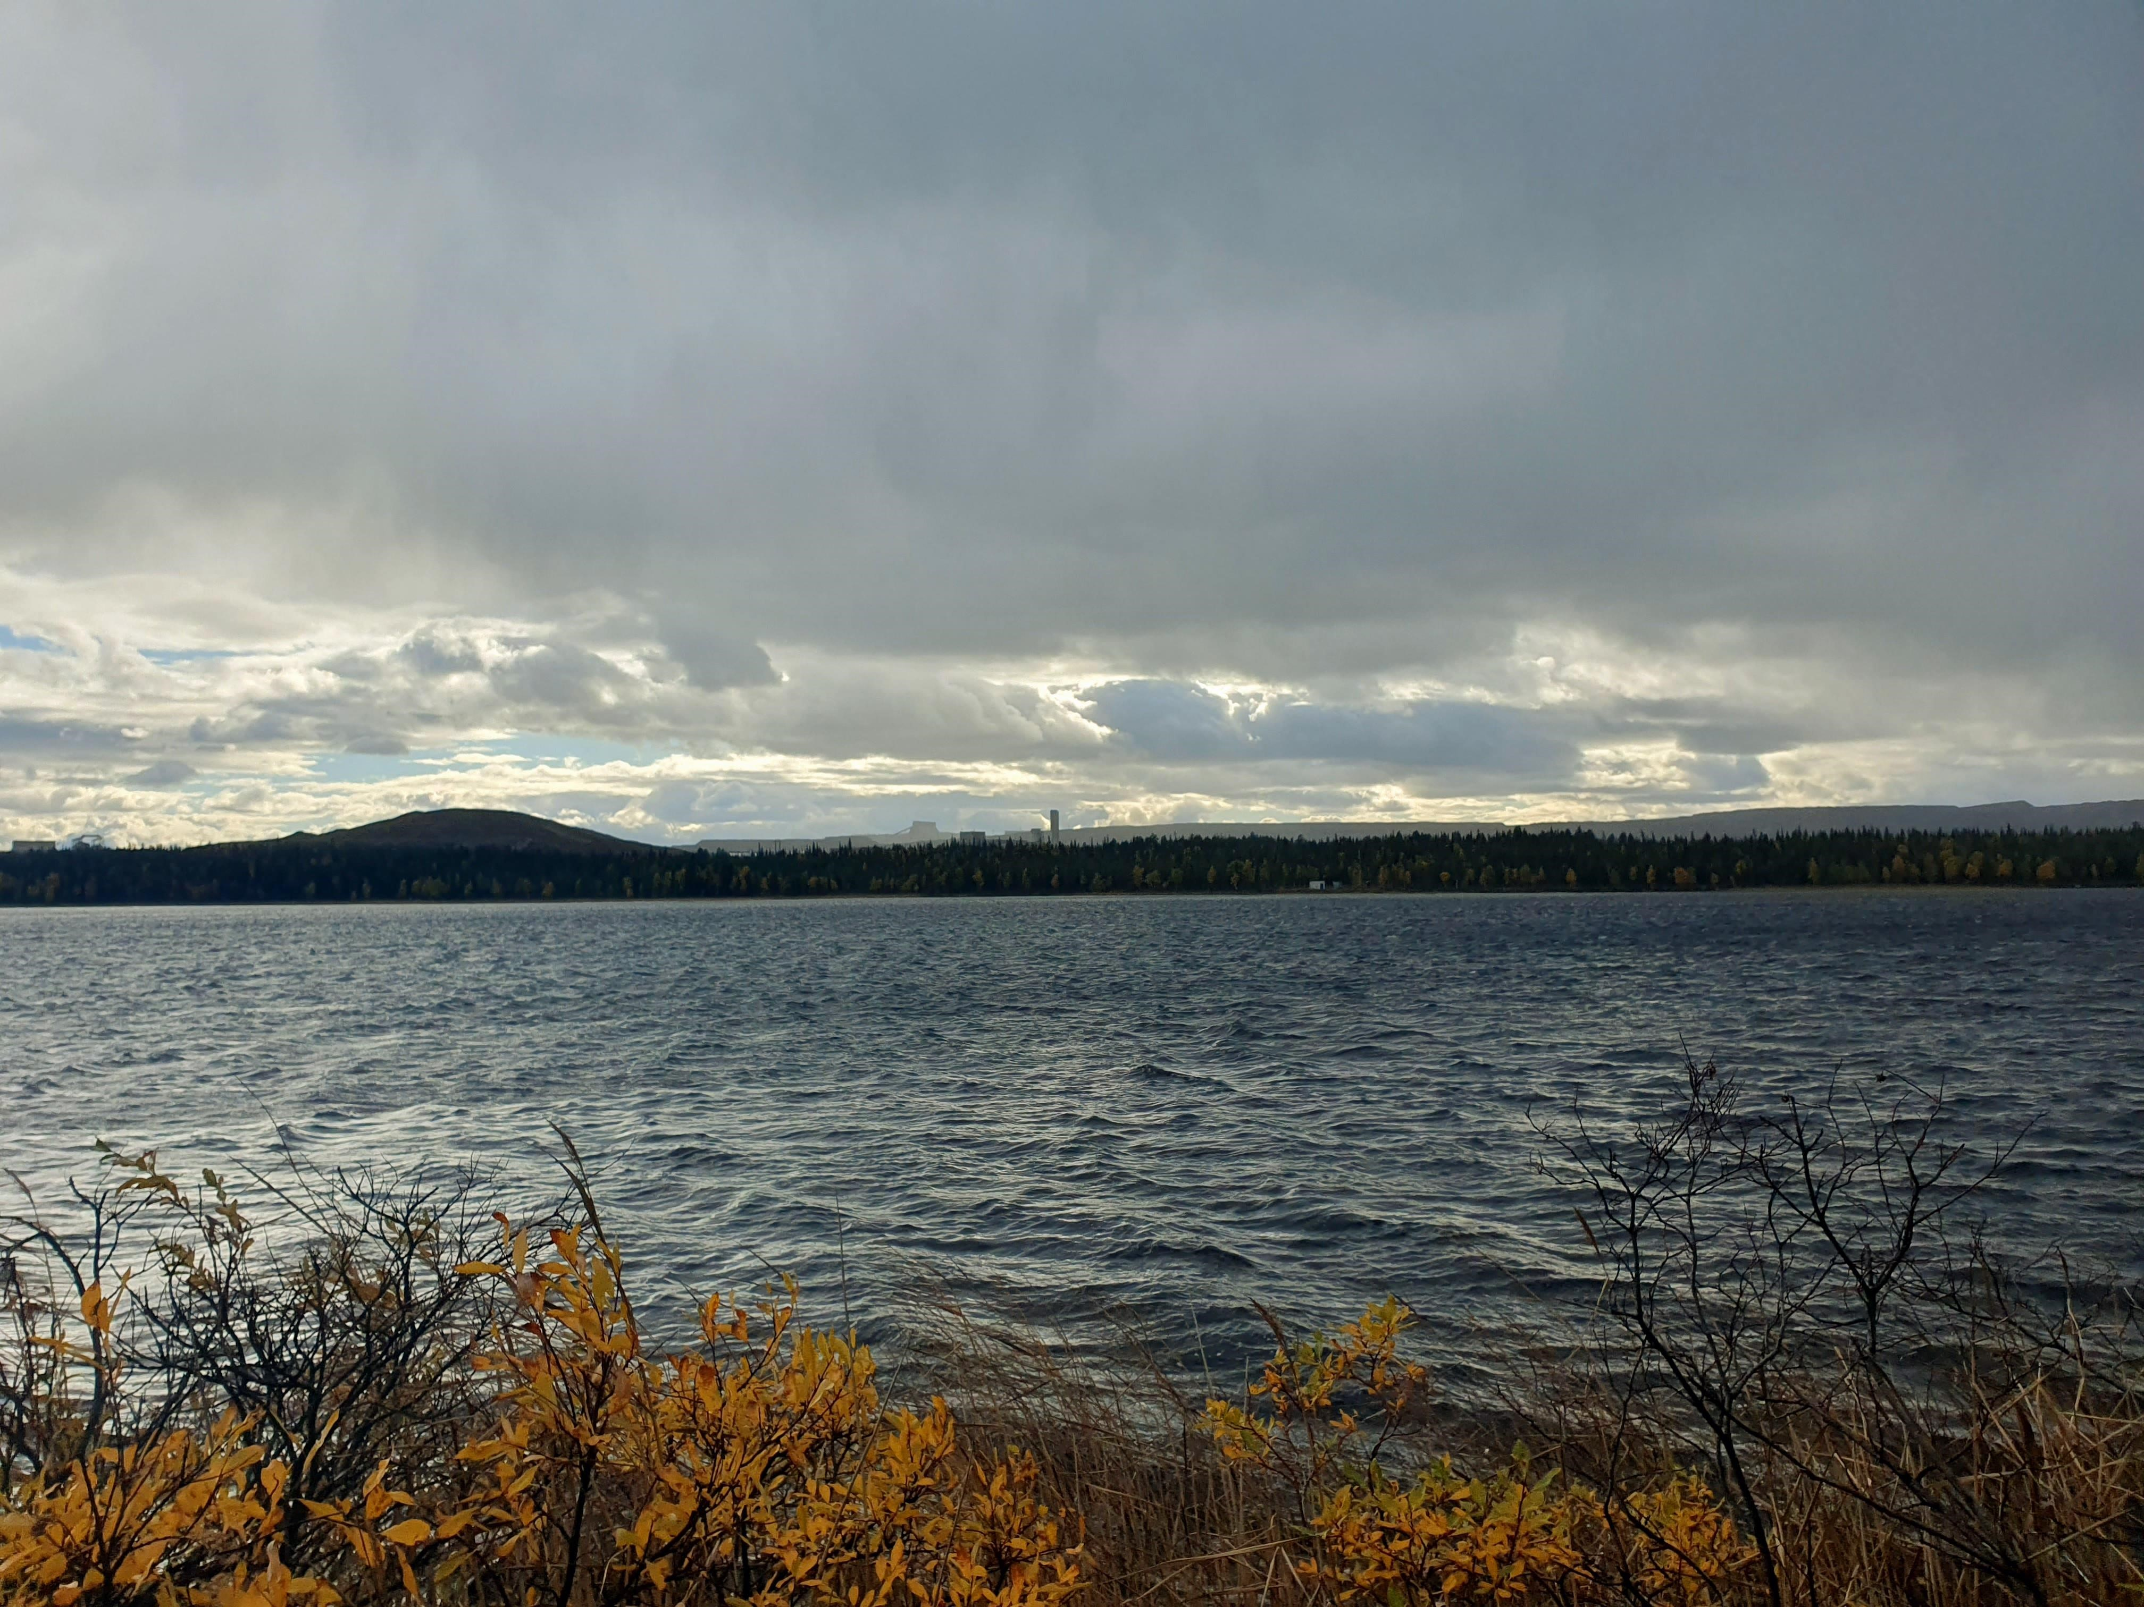
Aitik (Boliden), Gällivare
Copper ore
Expansive phases: The post-war period and the mining boom

Slide 7
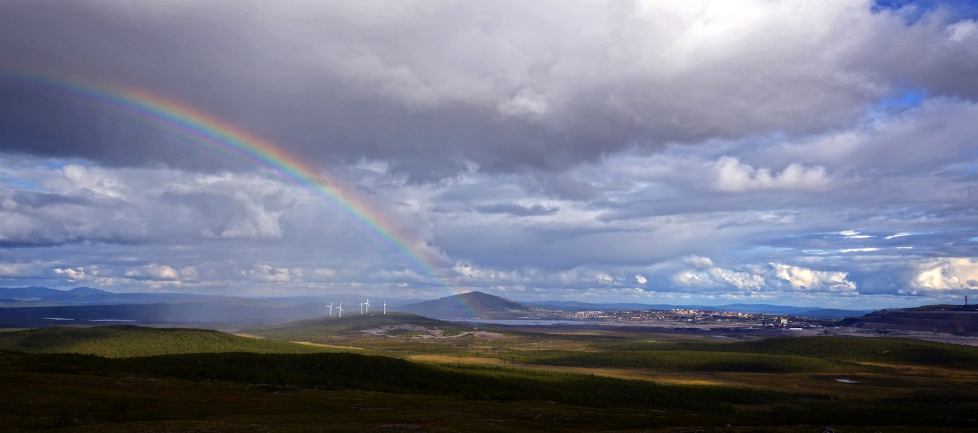
Viscaria (Copperstone), Kiruna Copper ore Expansive phase: The mining boom

Slide 8
Thank you!

