Slide 1
Overcoming impacts of mining exploration on community cohesion: The case of Aupaluk
Julie Fortin
PhD candidate in Public communication
Université Laval

Slide 2
Research Question
In the context of exploration phase mining projects, how the negotiation and deliberation capacity of indigenous communities is influenced by:
the power relationships between the actors?
the perception of the project?
the emotions generated?
the project's impacts on social cohesion?
Titre
Sous-titre

Slide 3
Theoritical Framework: Relationships Models between mining industry and communities
Type of Relationships | Forms of Power | Perception of mining activities | Impacts on community cohesion
Control shift | Empowerment Pragmatism | Economic leverage Capacity to manage mining development | -Risk of conflicts between leadership and community -Capacity building -Fostering dialogue among community members
Benefactor | Patronage Neopaternalism | Dependency Cooptation | -Weak negotiation power (fear of losing funding) -Risk of cognitive dissonance
Forced Union | Marginalisation Colonialism | Extractive violence Assimilation | -Threat to identity -Feeling of helplessness; -Political instability
Titre
Sous-titre

Slide 4
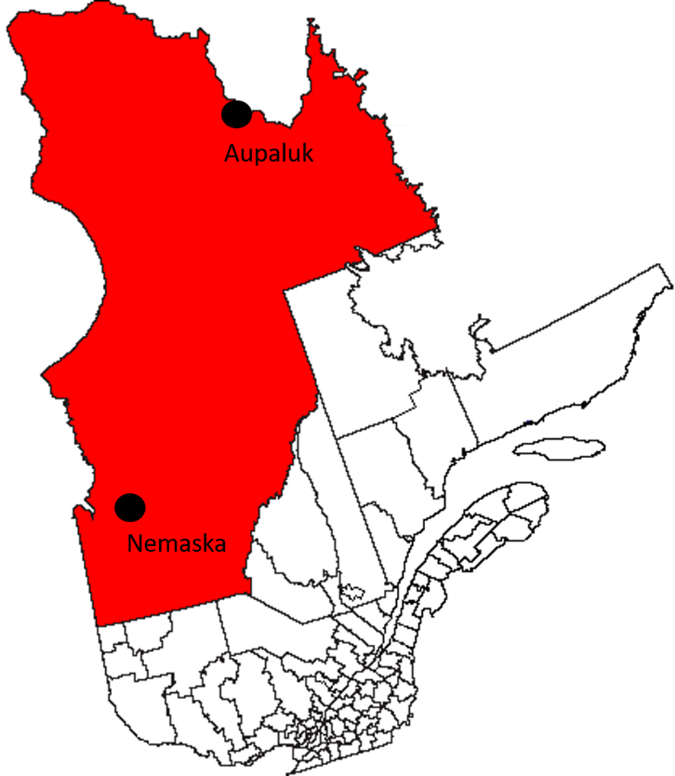
Research Methodology
Two case studies
Aupaluk: 23 semi-directed interviews
Participatory observation
Documentary analysis
Literature review
PhD Dissertation : The Silent Dimensions of Social
Acceptability in Indigenous Context
Titre
Sous-titre

Slide 5
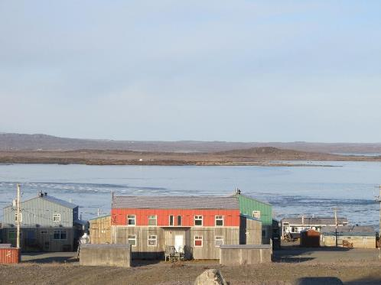
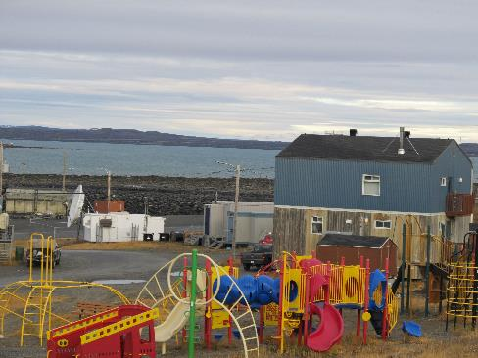
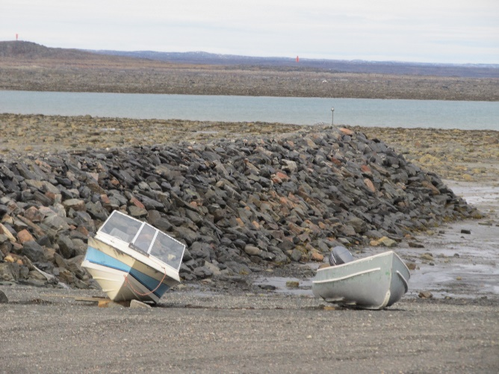
Aupaluk: "Where the earth is red"
Nunavik smallest community
Very high cost of living
Importance of traditional food
Historic Mining Claims
Sous-titre

Slide 6
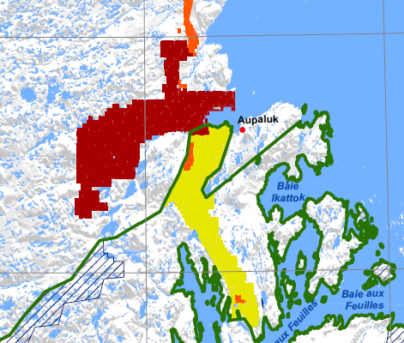
Baie-aux-Feuilles National Park Reserve
Region with strong ecological interest
Numerous archeological sites
One of the largest estuaries in Northern Quebec
Possibly the highest tides in the world
14 species of marine mammals
Aupaluk cannot be included within park boundaries due to mining claims

Slide 7
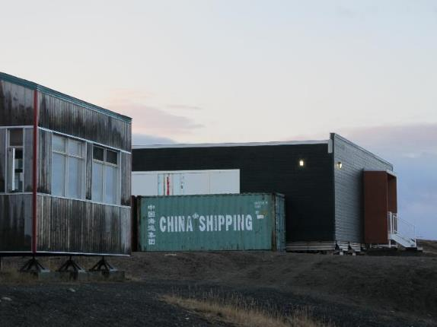
Mining Projects in Exploration Phase
Hopes Advance Project (Oceanic Iron Ore)
3 open pit mines
Located 25 km from the village
Deep sea port
Working camp
Power China International and Sinosteel

Slide 8
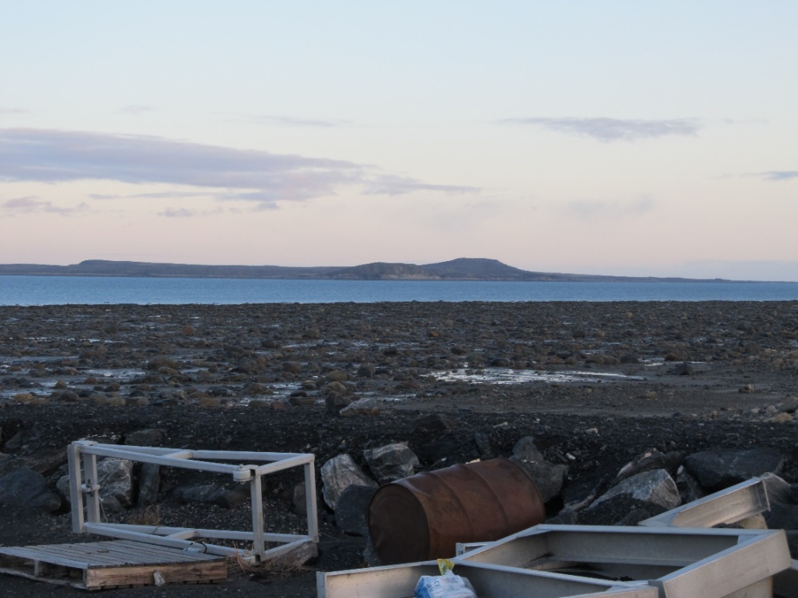
Anticipated impacts of the Hope Advance Project
“They’re gonna ruin the land and make a big mess in our land for the animals, not just animals but people too.” (Bobby, 2017)
“Sometimes we have no food and we get food from caribous, from fishing, from seal hunting, all of that. Once we’ll have mining, will it even affect the animals? Like, will they keep coming back? I still want the animals to come so that we can eat.” (Robbie, 2017)
“We would be giving the whole world to us but we would be paid for loosing part of ourselves.” (Mina, 2017)

Slide 9
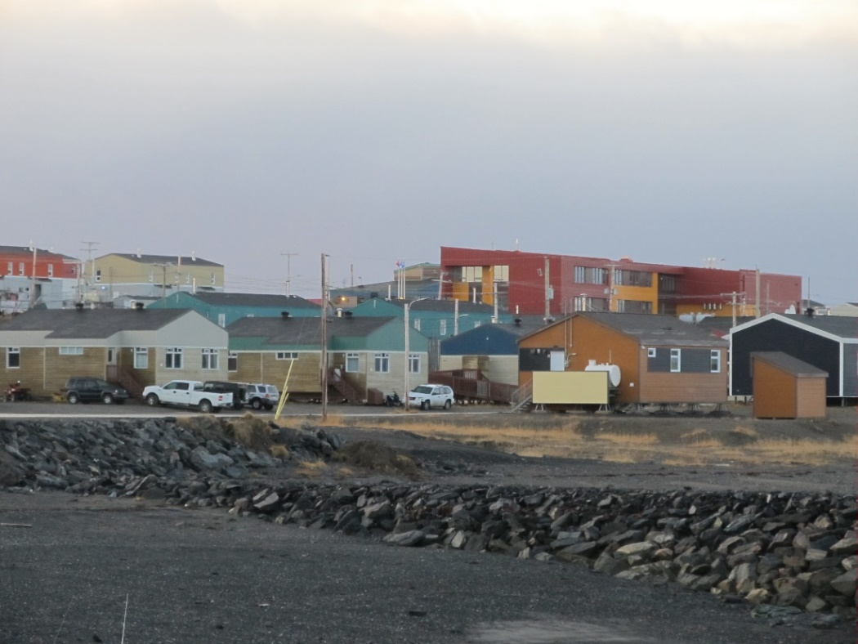
Anticipated Benefits
“People would be fed every day. Because people ran out of food right away after they receive pay check, the food doesn’t last long. Mining is gonna have people being fed everyday.” (Elisapi, 2017)
“I want to know, if the mining comes, are they gonna help the town? Like, we have very expensive food at the coop and we only have one transportation only, the airport. Are they gonna be able to help us to get more stuff we need?” (Rhoda, 2017)
“If they start a mine, I will just work with them, but I don’t want them to mine…” (Dereck, 2017)

Slide 10
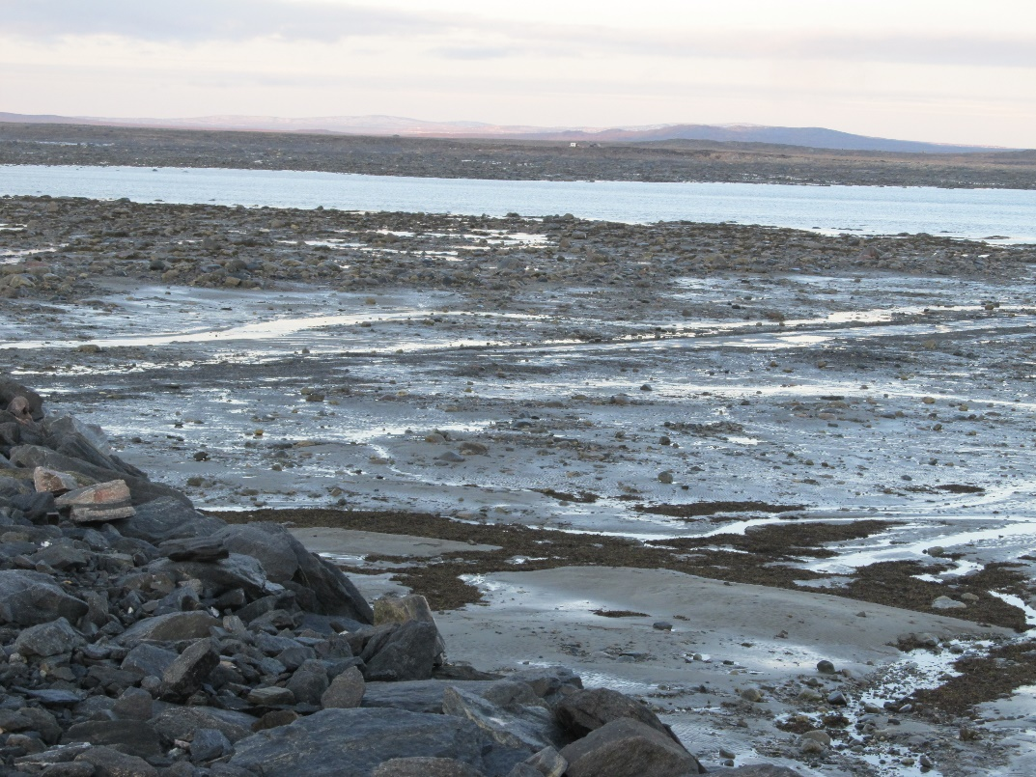
Scepticism about baseline environmental studies
“They studied the birds when the birds aren’t here. They studied the caribous when the caribous weren’t here. Like, they came at the wrong season to study... So it’s kind of scary.” (Henry, 2017)
In collaboration with Makivik Corporation, the community undertake a land use and traditional knowledge study

Slide 11
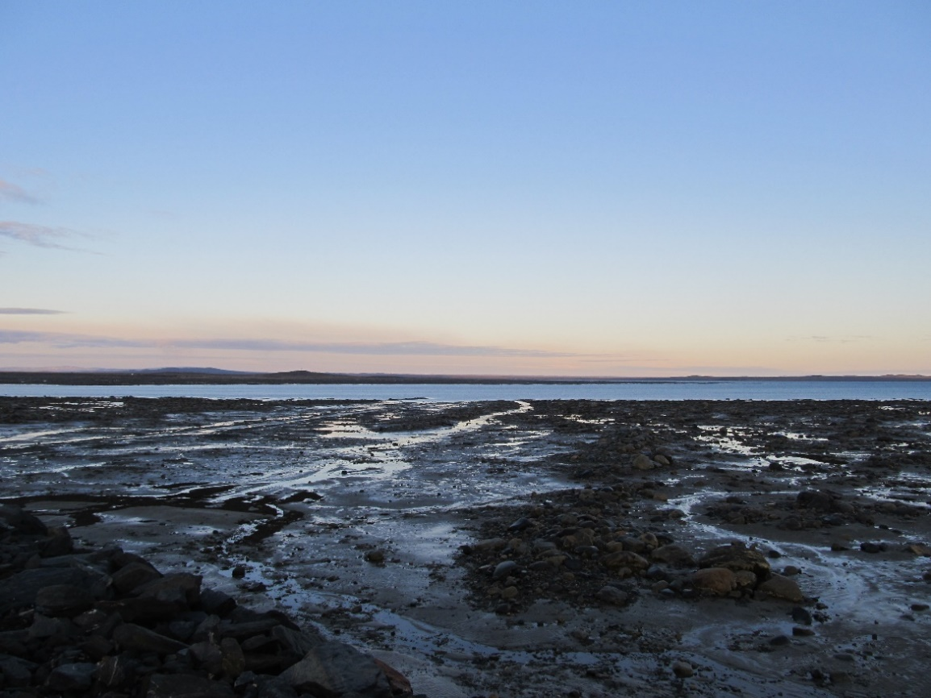
Historical Mining Claims and feeling of powerlessness
“We don’t feel that we have the power to consent or not, especially because these are historical claims form like the forties or fifties. People has been raised, this generation, the older generation, has been raised to believe that there’s always going to be a mining project here so...” (Mina, 2017)

Slide 12
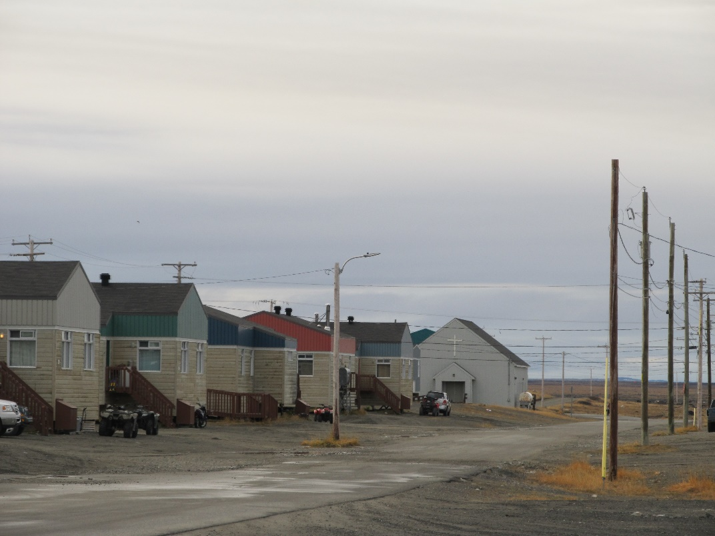
The project's impact on social cohesion
Private deal for home rental in the community:
“Oceanic was paying this family this much and that family that much, whatever they would agree to, they would pay them. And people said “no, they paid them more”. And people find out they were payed less than everyone. It was a mess, so for one year, they had ten of the forty houses in town, one quarter of the houses running their operations.” (Henry, 2017)

Slide 13
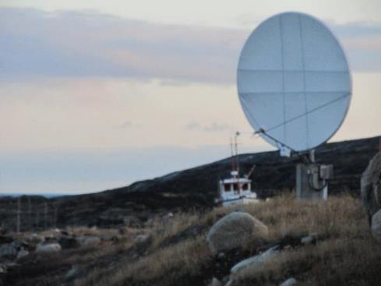
Difficulty to speak publicly about the mining project
“I’m doing meetings a lot about mining, but when they talk on the radio, sometimes I feel I’m helping mining just trying to explain it. They have to know this and that. I need to say that… Sometimes, they’re against me. The whole committees, but we’re doing our best for community.” (Louisa, 2017)
“They were talking about it on the FM many times, I wanted to say something but I was shut down, I couldn’t say nothing. Because we can’t stop them and we can do nothing…”(Rhoda, 2017)

Slide 14
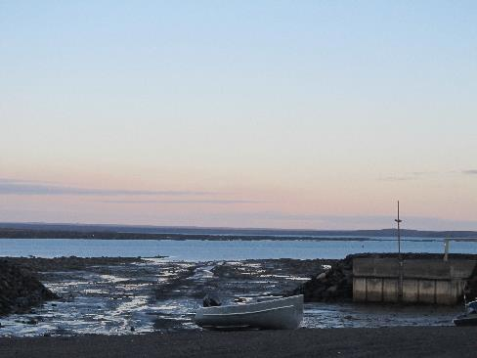
Factors that prevent community capacity for deliberation
Historical mining claims
Community conflicts
Difficulty to speak publicly about the mining project
Food insecurity and financial precariousness
Different visions of the future of the community
2020: Creation of the Atausirmik Nipiqalaurta working group : "Speaking with one voice"

Slide 15
How the community can regain control over mining exploration activities?
Keep the options opened by allowing mining exploration to proceed (seek information about mining activities and impacts)
Refuse to sign an IBA
Implement its own impact assessement mechanism (ex: health impact assessment)
Modify land use planning (mining claims vs national park, creation of "buffer zones" around the village)

Slide 16
Thank you!
Nakurmiik
Julie Fortin
Julie.fortin@com.ulaval.ca

