Slide 1
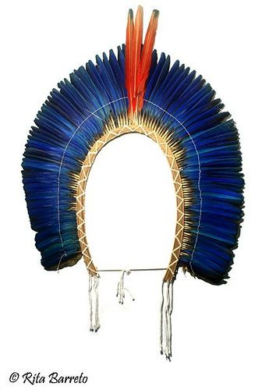
Power Relationships, Institutions and Mining Comparing Indigenous People’s Participation in Canada and Brazil
Sabrina Bourgeois, PHD student in political science
^{Laval University, Canada}
Ana Catarina Zema, postdoctoral researcher
^{Laval University, Canada}
^{MinErAL-REXSAC Virtual Seminar}
^{April 2021}

Slide 2
Introduction
"Recognition of rights in international legal instruments and national legislation is important but struggles over Indigenous rights ‘will ultimately be fought out on the ground’." (O’Faircheallaigh 2012: 532)
Question
What is the role of institutions and agency on the appropriation of free, prior and informed consent (FPIC)?

Slide 3
Free, prior and informed consent (FPIC) as an inhabited institution
Inhabited institutions approach
“Institutions are not inert categories of meaning; they are populated with people whose social interactions suffuse institutions with local force and significance." (Hallett and Ventresca 2016)
"People doing things together" – Conflict and/ or collaboration (Becker 1986)
Why it matters?
Consistent with the governance of resource development
"Different resource governance regimes emerge from the interactions between the various actors involved in the mining arena." (Le Meur et al 2013: 192)
"Institutional arrangements shape political outcome through the way in which they structure the rules of the games." (Rice 2019: 3)
"Whether and how FPIC is implemented depends on both the institutional context and the agency of the actors involved." (Papillon and Rodon 2019)

Slide 4
Free, Prior and Informed Consent (FPIC)
Main agreements
Indigenous and Tribal Peoples Convention (ILO 169, 1989)
United Nations Declaration on the rights of Indigenous peoples (UNDRIP, 2007)
FPIC is integrated in the corporate social license (Hanna and Vanclay 2013; Owen and Kemp 2014).
International Council on Mining and Metals (ICMM) – Indigenous Peoples and Mining: Position Statement (2013)
Word Bank – Environmental and Social Framework (2017)

Slide 5
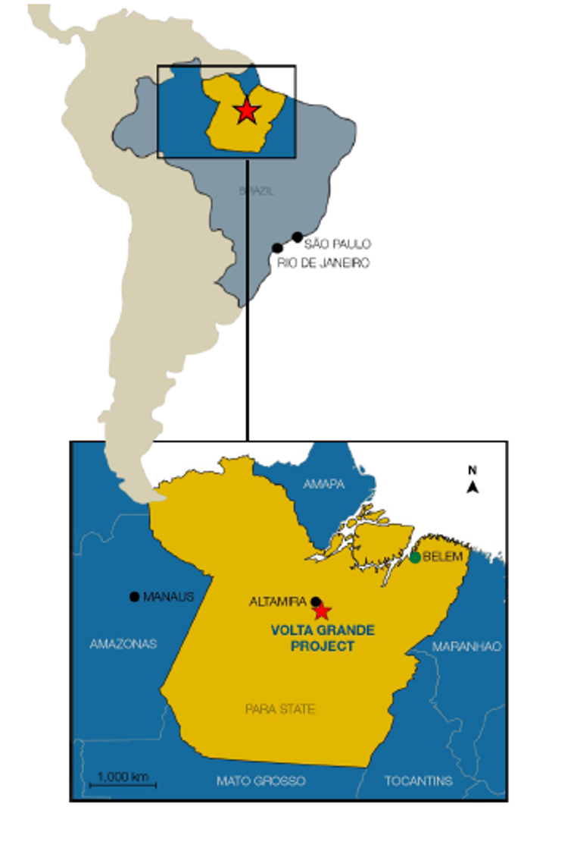
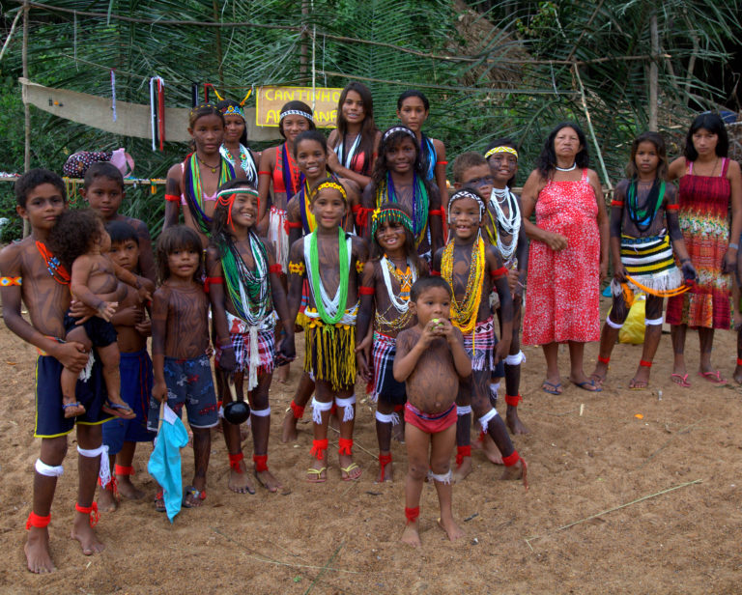
THE JURUNA PROTOCOL OF CONSULTATION
AND THE BELO SUN MINING PROJET

Slide 6
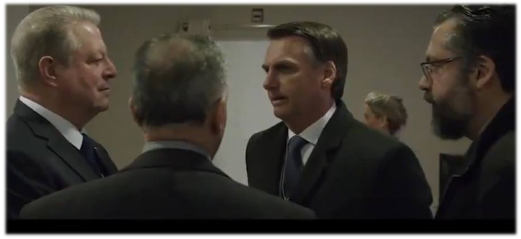
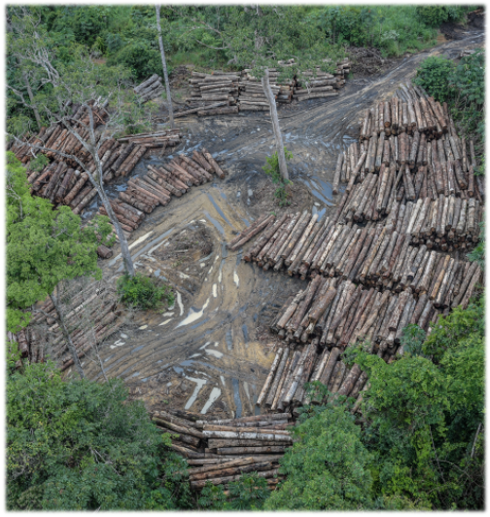
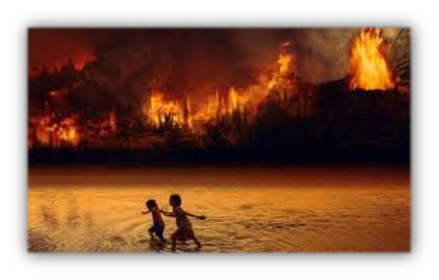
Legal and Political Context : Brazil
International commitments
UNDRIP
OAS DECLARATION ON THE RIGHTS OF INDIGENOUS PEOPLES
Legal framework
ILO Convention 169
Constitution Law, art. 231, par. 3
Political crisis
“We would very much like to exploit the Amazon together with the United States.” Bolsonaro, January 2019.

Slide 7
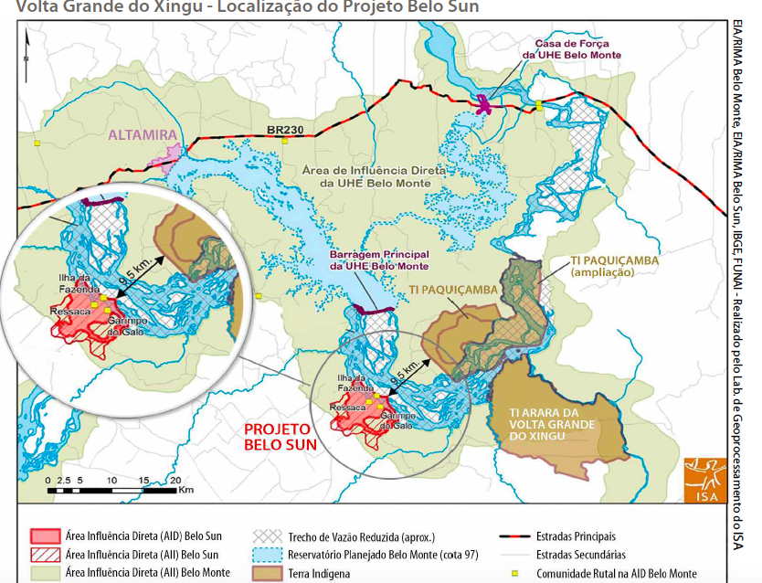
AFTER BELO MONTE DAM, THE BELO SUN MINING PROJECT
XINGU RIVER
« We are the owners of the Xingu river »
CACIQUE (CHIEF) GILIARDE JURUNA

Slide 8
THE JURUNA PROTOCOL
The Juruna Protocol is divided into three parts:
1) The first part describes who the Juruna are, their territory, the current socio-political context and the reasons why they decided to discuss, agree and publish their own consultation Protocol.
2) The second part answers the questions: what should be subjected to consultation, when, how, with whom and for what.
3) The third part reproduces Federal Constitution, ILO Convention 169 and UNDRIP articles referring to the right to consultation and consent.
The Juruna protocol :
See as an opportunity to stop history from repeating itself
Legal Victory
Empowerment / agency
Important precedent

Slide 9
Context: Canada
International commitments
Ø ILO 169/ UNDRIP – Parliament processes (Bill C-15 was tabled in December 2020)
Historical Legacy
Terra Nullius
Indigenous consent as foundation of treaties (legitimacy)
Legal framework
Constitution Law, art. 35
Duty to consult, accommodate, and in some circumstances, obtain consent

Slide 10
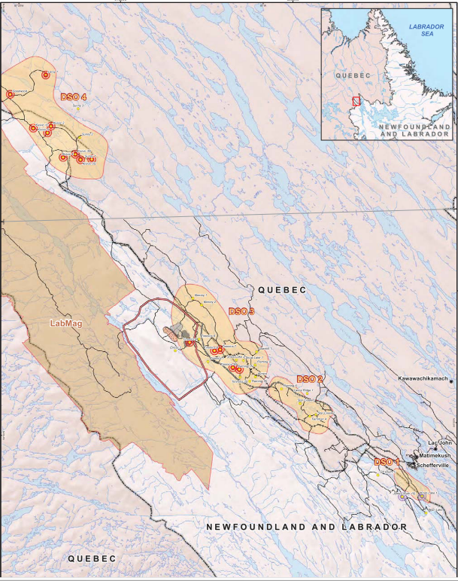
TSMC mining project
Quebec
Inuit from Nunavik
Naskapi Nation of Kawawachikamach
Innu from Matimekush Lac-John and
Uashat Mak Mani-Utenam
Labrador
Innu Nation
NunatuKavut

Slide 11
In Labrador, Innu nation and NunatuKavut
were consulted by the provincial government. One of the conditions of the benefit plan between NFL and TSMC was to negotiate agreements with them.
TSMC mining project
Formal decision-making processes in Quebec
Kativik Environmental Quality Commission (KECQ) / co-management board with the Inuit
Naskapi Nation of Kawawachikamach
Participated in the provincial consultation processes
Lawsuit to have a seat on the committee
Innu from Matimekush Lac-John and Uashat Mak Mani-Utenam
Refused to be consulted – do not recognize the legitimacy of KECQ
4 months of blockades

Slide 12
TSMC mining project
Treaties/ land claims negotiations have the potential to support Indigenous participation in the decision-making process in Canada – However, it’s not necessarily enough to create consent
Appropriation
Direct negotiation with the industry
Agency to be heard/ FPIC as a tool for self-determination (blockades, lawsuits, etc.)
4 IBAs/ 1 collaboration agreement (+1 Newfoundland & Labrador Benefits Plan)
Mining impacts and legal regulation as the main motivations for negotiation and accommodation for the Industry

Slide 13
Discussion
"It would be useful to see more comparisons of [Indigenous peoples’ agency] (…) to explore how different legal, political, economic, social and cultural contexts shape Indigenous communities’ engagements with companies." (Horowitz and al 2018: 9)
What do we learn?
Brazil and Canada comparison
Both states focus on consultation processes
Indigenous agency matters; they use many strategies to be heard and to express their self-determination and consent: co-management, lawsuits, protocols, blockades, alliances, agreements, etc.
Inhabited institutions approach enable us to make sense on how Indigenous peoples negotiated consent "on the ground"
Showcase how FPIC is negotiated differently depending on the actors and the "rules of the game“
Agency is always expressed within contexts/ pre-existing set of social structures
In both cases, Indigenous people's appropriation of FPIC enable them to participate or interfere on the decision-making of mining activities

Slide 14
Thank you! Obrigada! Merci!

